Slide 1
UNIT IV BACKUP - ARCHIVE AND REPLICATION
Introduction to Business Continuity
Backup architecture - Backup targets and methods
Data deduplication - Cloud-based and mobile device backup
Data archive - Uses of replication and its characteristics
Compute based - storage-based - and network-based replication
Data migration - Disaster Recovery as a Service (DRaaS).

Slide 2
Introduction to Business Continuity
1.1 Meaning of Business Continuity
Business Continuity (BC) refers to the ability of an organization to continue its critical business operations during and after a disruption or disaster.
A disruption may occur because of:
  Hardware failure , Software failure
  Power failure, Network failures
  Natural disasters such as floods, earthquakes, or cyclones
  Cyberattacks and ransomware
  Human errors , Data corruption , Fire or physical damage to the data center
The main objective of business continuity is to ensure that critical business services remain available with minimum interruption and data loss.

Slide 3
Example
Consider an online banking system. If its main data center becomes unavailable because of a power failure, customers should still be able to access their accounts and perform transactions.
To achieve this, the bank may use:
Primary Data Center → Backup/Replication → Secondary Data Center
If the primary data center fails, services can be transferred to the secondary site.

Slide 4
1.2 Need for Business Continuity
Organizations depend heavily on information systems and digital data. Any interruption can result in financial loss and damage to the organization's reputation.
Business continuity is required for the following reasons:
1. Prevents prolonged service interruption
It enables an organization to restore or continue critical services quickly after a failure.
2. Protects business data
Important business information such as customer records, financial information, employee records, and transaction data can be protected using backup and replication.
3. Reduces financial losses
Downtime can result in loss of sales, productivity, and customers. Business continuity minimizes the duration of downtime.

Slide 5
1.2 Need for Business Continuity
4. Maintains customer confidence
Customers expect services to be available continuously. Effective business continuity helps maintain customer trust.
5. Supports regulatory requirements
Many organizations are required to maintain data protection, availability, and disaster recovery procedures according to industry regulations.
6. Protects against disasters
Business continuity planning helps organizations prepare for both natural and man-made disasters.

Slide 6
1.3 Basic Business Continuity Process
Risk Identification
↓
Business Impact Analysis
↓
Continuity Strategy
↓
Backup and Recovery Planning
↓
Implementation
↓
Testing
↓
Continuous Improvement

Slide 7
1.4 Important Business Continuity Terms
Two important concepts used in business continuity and disaster recovery are:
Recovery Point Objective (RPO)
RPO defines the maximum acceptable amount of data loss measured in time.
In simple words:
RPO answers: "How much data can we afford to lose?“
Example
If an organization's RPO is 1 hour, its backup/replication system should allow recovery with no more than approximately 1 hour of data loss.
Suppose:
Last successful backup = 10:00 AM
Disaster occurs = 11:00 AM
With a 1-hour RPO, data generated after 10:00 AM may potentially be lost.
RPO values
High RPO → More data loss can be tolerated
Low RPO → Very little data loss can be tolerated

Slide 8
Recovery Time Objective (RTO)
RTO defines the maximum acceptable time within which a service or application should be restored after a disruption.
In simple words:
RTO answers: "How quickly must we recover?“
Example
If an organization's RTO is 2 hours, the affected application should be restored within 2 hours of the disruption.
Difference between RPO and RTO
RPO → Data loss tolerance
RTO → Downtime tolerance
For example:
  RPO = 30 minutes
  RTO = 2 hours
This means:
The organization can tolerate up to 30 minutes of data loss.
The service should be restored within 2 hours.

Slide 9
Backup architecture - Backup targets and methods

Slide 10
Introduction to Backup
Backup is the process of creating a copy of data and storing it in a separate location so that the data can be restored when the original data is lost, damaged, corrupted, or unavailable.
Backup is one of the most important components of a business continuity and disaster recovery strategy.
Examples of situations requiring backup
Accidental deletion of files
Hard disk failure
Server failure
Database corruption
Virus or ransomware attack
Software failure
Human error
Fire, flood, or other disasters

Slide 11
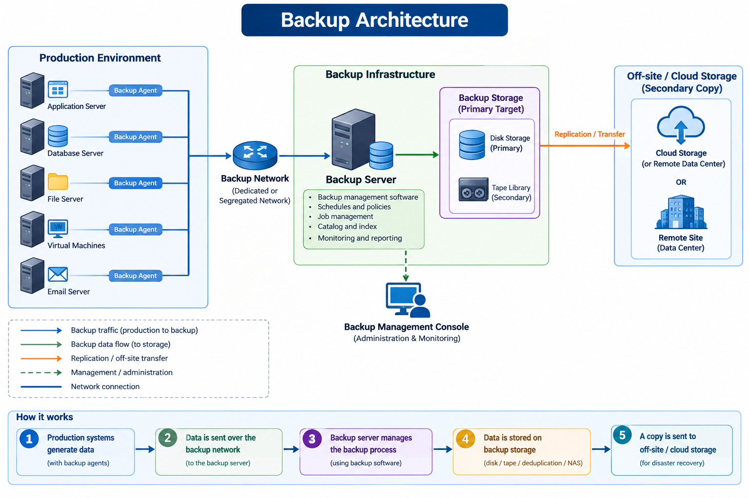
Backup Architecture

Slide 12
2.2 Backup Architecture
Backup architecture describes the arrangement of hardware, software, networks, storage devices, and backup processes used to create, manage, and restore backup copies.
A typical backup architecture consists of:
  Production servers
  Backup clients/agents
  Backup server
  Backup network
  Backup storage/target
  Backup management software
  Off-site or secondary storage

Slide 13
1. Production Server
The production server contains the original business data and applications.
Examples:
File server
Database server
Application server
Virtual machines
Email server
The data stored on these systems is protected through backup.

Slide 14
2. Backup Client or Agent
A backup agent is software installed on a production server or endpoint.
It helps the backup system:
Identify data to be backed up
Read the data
Send data to the backup system
Perform application-consistent backups
Support recovery
For example, an agent can be installed on a database server to coordinate the backup of database files.

Slide 15
3. Backup Server
The backup server manages the backup operations.
Its functions include:
  Scheduling backups
  Selecting data to be backed up
  Managing backup jobs
  Maintaining backup catalogs
  Managing backup devices
  Monitoring backup status
  Initiating restoration
The backup server acts as the central control point for the backup environment.

Slide 16
4. Backup Network
The backup network provides connectivity between production systems, backup servers, and backup targets.
A separate backup network can be used to prevent backup traffic from affecting normal application traffic.
Example
Production Network
│
├── Application Traffic
│
└── Backup Network
↓
Backup Storage

Slide 17
5. Backup Target
A backup target is the storage destination where backup data is stored.
Common backup targets include:
  Disk
  Tape
  Deduplicated storage
  Network Attached Storage (NAS)
  Cloud storage
  Object storage
  Backup targets are discussed in detail below.

Slide 18
6. Backup Management Software
Backup software controls and manages the complete backup process.
It provides features such as:
  Backup scheduling
  Backup policy creation
  Data selection
  Compression
  Encryption
  Deduplication
  Backup monitoring
  Recovery management
  Reporting

Slide 19
2.3 Backup Targets
A backup target is the destination where backup copies are stored.
The selection of a backup target depends on:
  Backup capacity
  Performance and Cost
  Recovery requirements
  Security
  Retention period
  Scalability
  Distance from the production site
The major backup targets are:
  Disk
  Tape
  Deduplication appliance
  NAS
  Cloud storage
  Object storage

Slide 20
1. Disk-Based Backup
In disk-based backup, backup data is stored on hard disk drives or solid-state drives.
Production Server
↓
Backup Server
↓
Disk Storage
Example
An organization may maintain a dedicated backup storage system containing several terabytes or petabytes of disk capacity.

Slide 21
2. Tape-Based Backup
Magnetic tape is a traditional backup medium used especially for long-term retention and archival purposes.
Production Server
↓
Backup Server
↓
Tape Library
↓
Magnetic Tapes
A tape library may contain multiple tape cartridges and automated tape drives.

Slide 22
3. Deduplication Storage
Data deduplication eliminates duplicate blocks or files before or during storage.
For example, suppose 10 backup copies contain the same large file. Instead of storing the same data repeatedly, the backup system can store one copy and maintain references to it.
Backup 1 ──┐
Backup 2 ──┤
Backup 3 ──┼──→ Deduplication ──→ Unique Data
Backup 4 ──┘
Benefits
Reduces storage requirements
Reduces backup storage cost
Can improve backup efficiency
Allows more backup versions to be retained

Slide 23
4. NAS as a Backup Target
Network Attached Storage (NAS) is a storage system connected to the network and can be used as a backup destination.
Servers
↓
Network
↓
NAS
↓
Backup Data
Advantages
Easy to deploy , Centralized storage , Accessible over the network , Scalable depending on the NAS system
Disadvantages
Depends on network availability
May become a target for ransomware if not properly protected
Performance depends on network and storage capacity

Slide 24
5. Cloud as a Backup Target
Cloud storage can be used as an off-site backup destination.
Production Data
↓
Backup Server
↓
Internet / WAN
↓
Cloud Storage
Advantages
Off-site protection , Highly scalable , No need to maintain all physical storage locally, Useful for disaster recovery
Can support geographically distributed protection
Disadvantages
Depends on network connectivity, Data transfer can take time
Recurring storage and data-transfer costs may apply
Security and access controls must be properly configured

Slide 25
2.4 Backup Methods
Backup methods determine how much data is copied during each backup operation.
The three fundamental backup methods are:
  Full backup
  Incremental backup
  Differential backup

Slide 26
1. Full Backup
A full backup copies all selected data every time the backup is performed.
Example
Suppose:
Monday → 100 GB
Tuesday → 10 GB new/changed data
Wednesday → 5 GB new/changed data
A full backup on each day copies the complete 100 GB or current dataset.
Monday → Full Backup → 100 GB
Tuesday → Full Backup → 100+ GB
Wednesday → Full Backup → 100+ GB

Slide 27
1. Full Backup
Advantages
  Simple backup process
  Fast and simple restoration
  Each backup contains the complete dataset
  Easy to manage
Disadvantages
  Requires more storage
  Takes longer to complete
  Generates more backup traffic
Suitable for
  Small datasets
  Periodic complete protection
  Situations where fast recovery is important

Slide 28
2 Incremental Backup
An incremental backup copies only the data that has changed since the most recent backup of any type.
Example
Assume the following:
Monday
Full Backup = 100 GB
Tuesday
Changed data = 10 GB
Incremental Backup = 10 GB
Wednesday
Changed data = 5 GB
Incremental Backup = 5 GB
Thursday
Changed data = 8 GB
Incremental Backup = 8 GB
Total backup storage:
100 + 10 + 5 + 8 = 123 GB
Restoration
To restore Thursday's data, we generally need:
Monday Full + Tuesday Incremental + Wednesday Incremental + Thursday Incremental

Slide 29
2. Incremental Backup
Advantages
Requires less storage
Faster backup
Reduces network traffic
Suitable for frequent backups
Disadvantages
Restoration can be slower
Multiple backup sets may be required
If one required incremental backup is damaged or unavailable, recovery may be affected

Slide 30
3. Differential Backup
A differential backup copies all data changed since the last full backup.
Example
Monday
Full Backup = 100 GB
Tuesday
Changed since Monday = 10 GB
Differential = 10 GB
Wednesday
Changed since Monday = 15 GB
Differential = 15 GB
Thursday
Changed since Monday = 23 GB
Differential = 23 GB
Notice that the differential backup becomes larger over time until the next full backup.

Slide 31
3. Differential Backup
Restoration
To restore Thursday:
Monday Full + Thursday Differential
Only two backup sets are required.
Advantages
Faster restoration than incremental
Easier to manage
Only the latest differential and full backup are generally required
Disadvantages
Requires more storage than incremental backup
Backup size increases until the next full backup

Slide 32
Data archive - Uses of replication and its characteristics

Slide 33
3. Data Archive
3.1 Introduction
Data archiving is the process of moving inactive or less frequently accessed data from primary storage to a separate storage system for long-term retention and future reference.
As organizations continuously generate large amounts of data, keeping all data on expensive primary storage is inefficient. Archiving helps organizations move older data to lower-cost, high-capacity storage while keeping it available when required.
Simple Example
A college may have student records from the last 15 years.
Current-year records → Primary storage
Older student records → Archive storage

Slide 34
ORGANIZATIONAL DATA
|
-------------------
| |
Active Data Inactive Data
| |
Primary Storage Archive Storage
|
Long-term Retention

Slide 35
3.2 Objectives of Data Archiving
The major objectives of data archiving are:
  Long-term preservation of important data.
  Reduction of primary storage usage.
  Improvement of storage performance by removing inactive data.
  Cost reduction by moving data to economical storage.
  Compliance with legal and regulatory requirements.
  Easy retrieval of historical information.
  Protection of valuable business records.

Slide 36
3.3 Characteristics of Data Archive
A good data archive generally has the following characteristics:
1. Long-term retention
Data is preserved for a long period, sometimes for several years or decades.
2. High capacity
Archive systems should be capable of storing large volumes of historical data.
3. Low cost
Archived data is generally stored on economical storage compared with high-performance primary storage.
4. Data integrity
Archived information must remain accurate and uncorrupted throughout its retention period.
5. Easy retrieval
Although archived data may not be accessed frequently, it should be retrievable when required.

Slide 37
3.3 Characteristics of Data Archive
6. Security
Archived information must be protected against:
  Unauthorized access
  Modification
  Accidental deletion
  Malware
  Data corruption
7. Retention management
Organizations can define how long different types of data should be retained.

Slide 38
3.5 Data Archiving Process
A typical archiving process is:
Active Data
↓
Identify Inactive Data
↓
Apply Archive Policy
↓
Move Data to Archive
↓
Index / Catalog Data
↓
Long-Term Retention
↓
Retrieve When Needed

Slide 39
3.5 Data Archiving Process
Step 1 – Identify data
The organization identifies data that is no longer frequently accessed.
Step 2 – Apply archive policy
Rules are applied based on:
Age
Access frequency
Data type
Legal requirements
Business requirements
Step 3 – Move data
The selected data is moved from primary storage to archive storage.

Slide 40
3.5 Data Archiving Process
Step 4 – Catalog the data
Metadata and indexing information are maintained so that archived data can be located later.
Step 5 – Retain the data
The data is preserved according to the organization's retention policy.
Step 6 – Retrieve when required
Users can retrieve archived data whenever it is needed.
Backup = Recover lost data
Archive = Preserve old data

Slide 41
4. Replication
4.1 Introduction to Replication
Replication is the process of creating and maintaining a copy of data on another storage system or location.
The replicated copy can be used when the primary data becomes unavailable.
Basic concept
Primary Storage
|
| Replication
↓
Secondary Storage
|
Recovery / Access
Replication is an important technology used in business continuity, disaster recovery, and high-availability environments.

Slide 42
4.3 Uses of Replication
1. Disaster Recovery
Replication maintains a copy of data at a different location.
If the primary site is affected by a disaster, the replicated data can be used for recovery.
2. Business Continuity
Replication helps organizations continue critical operations when the primary system fails.
3. High Availability
A replicated system can provide access to data even when one storage system becomes unavailable.
Application
|
-------------
| |
Storage A Storage B
| |
----Replication----
If Storage A fails, Storage B can potentially provide access to the required data.

Slide 43
4.3 Uses of Replication
4. Minimize Data Loss
Frequent replication can reduce the amount of data lost during a failure.
This is especially important for systems with a low Recovery Point Objective (RPO).
5. Load Distribution
In some environments, replicated copies can be used to distribute workloads.
For example, one copy may serve production operations while another is used for reporting or analytics.
6. Data Migration
Replication can help move data from one storage system to another with reduced disruption.
7. Testing and Development
A replicated copy can sometimes be used to create test or development environments without directly affecting production data.

Slide 44
4.7 Characteristics of Replication
The important characteristics of replication are:
1. Data synchronization
Replication maintains a copy of data between primary and secondary systems.
2. High availability
A replicated copy can help maintain data availability when the primary system fails.
3. Reduced downtime
Replication can reduce the time required to recover critical services.
4. Disaster protection
Remote replication protects against site-level disasters.
5. Low RPO
Frequent replication can provide a low Recovery Point Objective.

Slide 45
4.7 Characteristics of Replication
6. Scalability
Replication can be implemented across multiple systems depending on business requirements.
7. Automation
Modern replication systems can automatically replicate changes without manual copying.
8. Geographic separation
Remote replication allows copies to be maintained at different physical locations.
9. Consistency
Replication mechanisms should maintain consistency between source and destination data according to the selected replication mode.
10. Performance consideration
  Replication consumes:
  Network bandwidth
  Storage resources
  Processing resources
Therefore, replication must be properly designed.

